Slide 1

MyPDP
I don’t teach Data Analytics. I teach the student. Data Analytics is just my tool. --- Dr. Lee
Notes:
"Good morning, esteemed colleagues, mentors, and members of the Faculty Success Academy. As I stand here today, it marks not just the culmination of a year-long journey of professional growth and learning, but also a moment of profound reflection and appreciation. This academy has been a transformative experience, one that has allowed me to delve deeply into the intricacies of teaching and scholarship, particularly in the realm of Data Analytics and Data Science. It has been an extraordinary journey of discovering new methodologies, embracing innovative teaching techniques, and refining my approach to education.
This year at the Academy has been a testament to the power of dedicated mentorship, collaborative learning, and the relentless pursuit of excellence in our field. It's an honor to be part of a community that values and nurtures faculty development with such commitment. As I share insights and experiences from this journey, I am reminded of the continuous support and guidance I've received, especially from my mentor, Dr. Coffman, and my esteemed colleagues. Their influence has been pivotal in shaping not just my teaching practices but also my perspective towards lifelong learning and professional development."

Slide 2
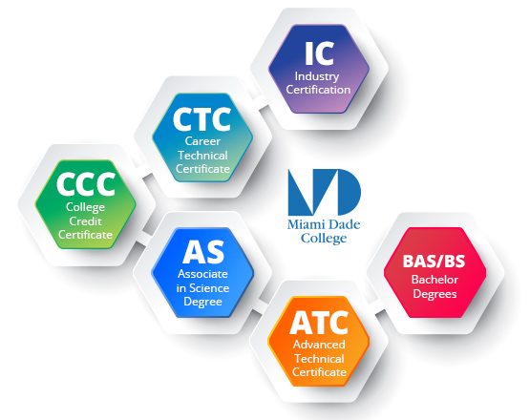

Strive for Excellence
Commitment to Teaching DA and DS
Enhanced Interpersonal Engagement
Up-to-Date Industry Expertise
Innovative Teaching Practices
Focused Professional Development
Notes:
In my commitment to teaching Data Analytics and Data Science, I have consistently integrated real-world industry projects into our curriculum, allowing students to engage with actual datasets and develop their analytical skills in a practical setting. This hands-on experience is complemented by a blended learning approach that marries online resources with interactive sessions and hands-on labs, thereby enabling students to grasp complex algorithms and data models effectively. This dynamic combination ensures that the theoretical aspects of data science are rooted in practical application, fostering a deep understanding of the discipline.
My teaching philosophy is further characterized by fostering effective interpersonal skills through collaborative projects that enhance teamwork and communication abilities among students. By maintaining open office hours and encouraging active class participation, I create a supportive learning environment that values open dialogue and feedback. Moreover, my dedication to staying abreast of industry trends through webinars and workshops, along with my active engagement in predictive analytics research, ensures that my expertise is both current and relevant. Innovative teaching methods, such as the analysis of case studies from leading tech companies and organizing guest lectures, provide students with valuable real-world insights. My pursuit of professional development, through certifications and the application of feedback for course improvement, reflects my unwavering commitment to excellence and growth in the ever-evolving field of Data Analytics.
-----
1. Commitment to Teaching in Data Analytics and Data Science
Incorporating Real-World Projects: I integrate current industry projects into the curriculum, allowing students to analyze real datasets, enhancing their practical skills.
Blended Learning Approach: I use a combination of online resources, interactive sessions, and hands-on labs to teach complex algorithms and data models.
2. Effective Interpersonal Skills
Collaborative Projects: I facilitate group projects that require students to collaborate on data analysis tasks, fostering teamwork and communication skills.
Open Office Hours: By maintaining open office hours and encouraging active class participation, I ensure open lines of communication with students.
3. Expertise in Data Analytics and Data Science
Staying Ahead of Industry Trends: Regularly attending webinars and workshops in machine learning and big data to bring the latest industry insights into the classroom.
Research and Publication: I actively contribute to research in predictive analytics, sharing findings with students to bridge the gap between academia and industry.
4. Innovative Teaching Techniques in Data Science
Case Study Analysis: Each semester, I introduce case studies from leading tech companies to demonstrate practical applications of data science.
Guest Speakers and Workshops: Hosting industry experts for guest lectures and workshops to provide students with exposure to real-world scenarios and networking opportunities.
5. Continuous Professional Growth in Data Analytics
Professional Certifications: Pursuing advanced certifications in data visualization and big data technologies to enhance teaching methodology.
Feedback-Driven Improvement: Regularly soliciting and implementing feedback from students and peers to refine course content and delivery.

Slide 3
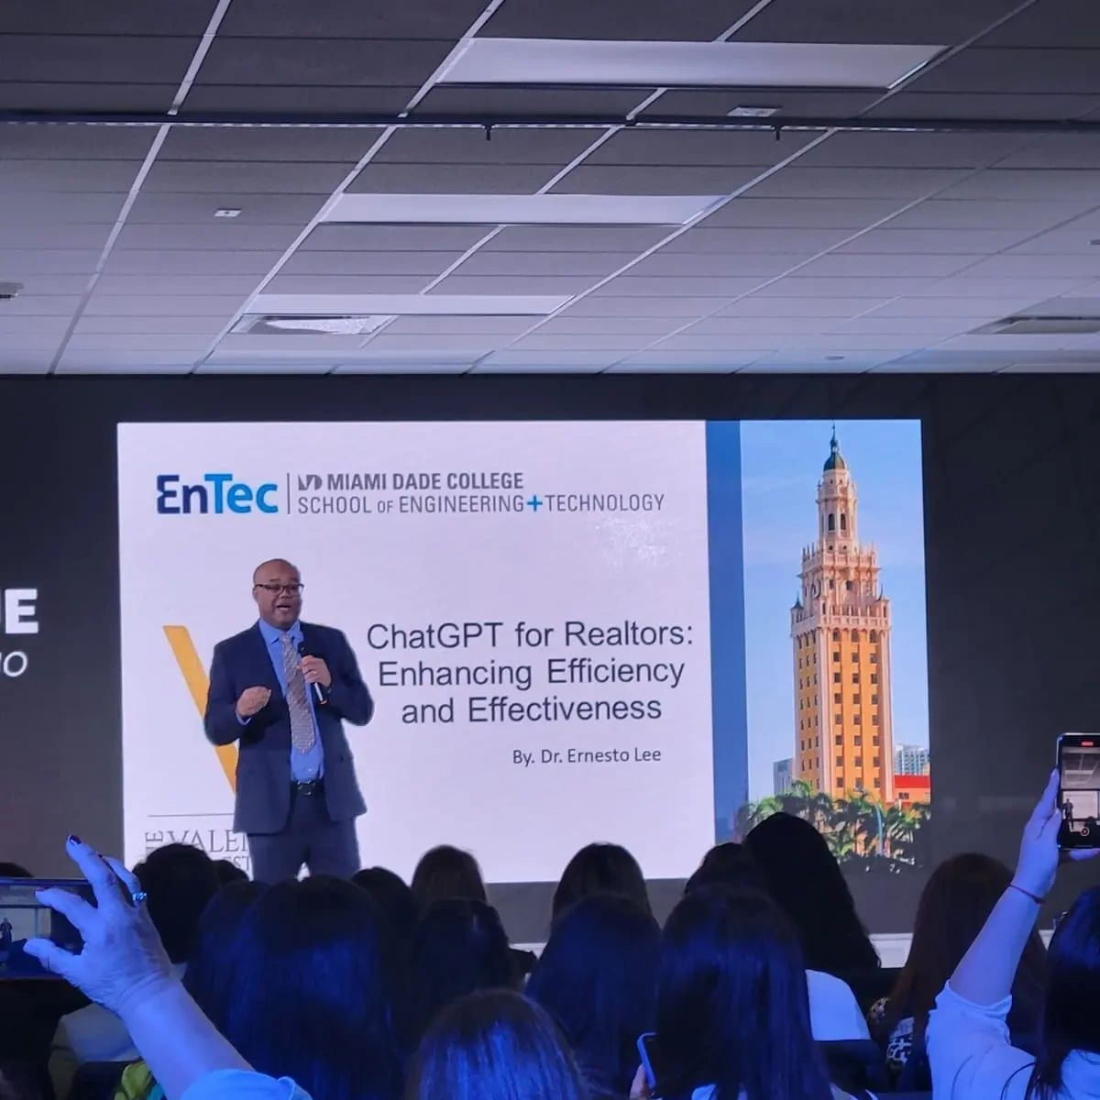
Motivation
“It is the supreme art of the teacher to awaken joy in creative expression and knowledge.”
–Albert Einstein
Notes:
"In my tenure at Miami Dade College, I have endeavored to make Data Analytics and Data Science not just subjects to be learned, but catalysts for curiosity and real-world engagement. My classroom is a vibrant hub where data analytics is not only taught but experienced through the lens of innovation and real-time application, extending my passion for the subject into college and community initiatives that underscore the impactful reach of data science. This commitment to education transcends traditional lecture formats to create a learning experience that is as diverse and dynamic as our student body.
Embracing the unique challenges of teaching at an institution as inclusive as ours, I have tailored my curriculum to be both challenging and accessible, encouraging students to not only master the fundamentals but to unlock the potential data science holds for their futures. By fostering an environment that celebrates perseverance and offering personalized mentorship, I have seen my students overcome the rigors of subjects like algorithmic programming with resilience and success. As a mentor and leader, I am driven by the shared vision of educational excellence, leveraging interdisciplinary collaboration to illustrate the breadth of data science, and by providing flexible, real-world learning scenarios, I ensure that our students' education is relevant to all aspects of their lives. In every facet, my teaching is fueled by the belief that education is a transformative force, one that I am committed to championing through continuous personal and professional growth."
-------
"As a faculty member passionate about Data Analytics and Data Science, my journey at Miami Dade College is not just about imparting knowledge, but about igniting a spark of curiosity and innovation in my students. My classroom is a dynamic space where real-time data tools come alive, making learning not just informative but truly engaging. This passion extends beyond the classroom walls, as I actively participate in college and community initiatives to showcase the transformative power of data science.
Understanding and embracing the challenges of teaching in an open-access environment, I recognize the diversity in the backgrounds and skill levels of my students. This awareness drives me to continuously adapt my curriculum, ensuring it remains relevant, challenging, and accessible. Whether it's introducing the latest trends in big data or machine learning, I am committed to setting high educational goals, pushing my students to explore beyond the basics and understand the vast career opportunities that await them in the field of data science.
Believing firmly in the potential of every student, I strive to create an environment where perseverance is celebrated, especially when tackling complex subjects like algorithmic programming. I provide personalized support, offering extra sessions and one-on-one mentoring, reinforcing my belief in their capabilities.
My role extends to being a leader among my peers. By spearheading collaborative projects that cut across various disciplines, I demonstrate the wide applicability of data science. I also share my insights with fellow faculty through workshops, contributing to a collective effort towards educational excellence.
Lastly, understanding the multifaceted roles our students play as learners, workers, and family members, I offer flexible learning options. This flexibility, coupled with the inclusion of real-life case studies, acknowledges their diverse responsibilities while making education practical and relatable.
In every aspect of my teaching, I am motivated by a desire not just to educate but to inspire and empower. It's this motivation that forms the core of my Personal Development Plan, reflecting a commitment to excellence in teaching and an unwavering belief in the transformative power of education."
Lecture Notes: Motivation in Teaching Data Analytics and Data Science
1. Passion for Impact in Education
Classroom Innovation: My passion for data science drives me to innovate in the classroom, using real-time data analytics tools to make learning dynamic and engaging.
Beyond the Classroom: Actively participating in college initiatives and community outreach programs to promote the importance and applicability of data science.
2. Embracing Open Access Education Challenges
Diverse Learning Needs: Acknowledging and adapting to the varied backgrounds and skill levels of students at MDC, creating an inclusive learning environment.
Continuous Curriculum Adaptation: Regularly updating course materials to reflect the latest trends in data analytics, ensuring relevance and challenge.
3. Setting High Educational Goals
Aspiring Beyond the Basics: Encouraging students to delve deeper into complex topics like machine learning and big data, fostering a culture of high achievement.
Professional Pathways: Guiding students to understand the diverse career opportunities in data science, from business intelligence to research analytics.
4. Belief in Student Potential
Encouraging Perseverance: Cultivating a classroom atmosphere where perseverance is valued, especially in challenging subjects like algorithmic programming and statistical analysis.
Personalized Support: Offering extra help sessions and one-on-one mentoring for students who need additional assistance, reinforcing the belief in their potential.
5. Leadership Among Faculty
Collaborative Projects: Leading interdisciplinary projects with other departments, demonstrating the applicability of data science across fields.
Faculty Workshops: Conducting workshops for fellow faculty members to share insights and strategies for effective teaching in data science.
6. Understanding Student Roles
Flexible Learning Options: Providing flexible assignment deadlines and online resources, acknowledging the busy schedules of students who may be working or have family commitments.
Real-Life Examples: Incorporating case studies that relate to real-life scenarios students might encounter in their professional or personal lives.

Slide 4
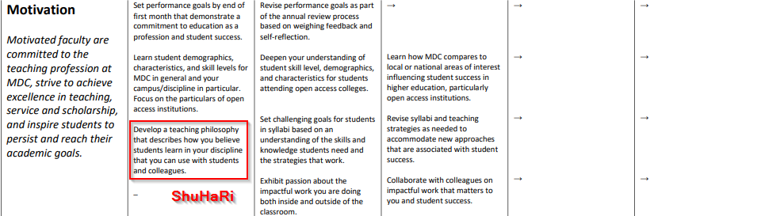
Motivation: ShuHaRi

Slide 5
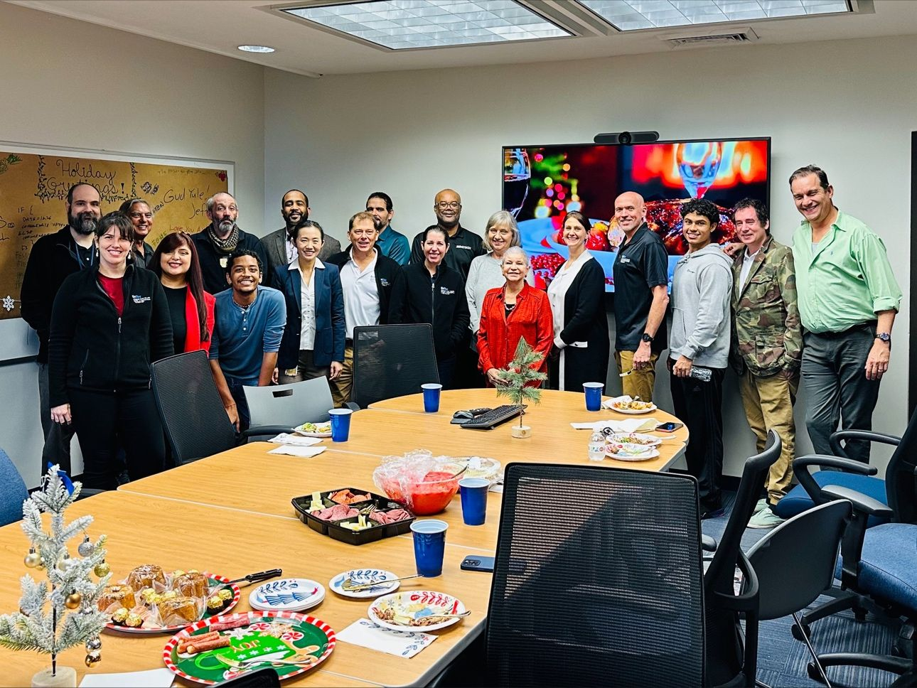
Interpersonal Skills
“Your career success in the workplace of today – independent of technical expertise – depends on the quality of your people skills.”
–Max Messmer
Notes:
I have dedicated myself to cultivating an educational environment that is as inclusive as it is enriching. My classroom is a microcosm of diversity and collaboration, where every student is encouraged to bring their unique perspective to the table, fostering a sense of community and belonging. This commitment to inclusivity goes hand in hand with academic rigor, ensuring that every learner, irrespective of their background, is engaged and supported in their educational journey. My teaching philosophy is underpinned by the conviction that a supportive environment is the bedrock upon which students can build confidence and achieve academic success.
The essence of my role also lies in mastering the interpersonal nuances required to navigate the intricate dynamics of classroom and collegial interactions. Through a balanced blend of respect, diplomacy, and ethical consideration, I facilitate a learning space that is conducive to open dialogue and mutual growth. Effective communication and collaboration are not merely pedagogical tools but are foundational to forging strong, empathetic connections with students and peers alike. In every interaction, whether it's mentoring during office hours or teaming up for departmental projects, I strive to embody and impart the interpersonal skills essential for success both within and beyond the walls of Miami Dade College."
----
"In my role as a Data Analytics and Data Science educator at Miami Dade College, fostering a classroom environment that is not only inclusive but also supportive and conducive to learning is a cornerstone of my teaching philosophy. I strive to create a space where every student feels valued and empowered to contribute, regardless of their background or skill level. This inclusivity extends beyond academic support; it's about building a community within the classroom where respect and support are the norms. Whether it's through group activities, peer-to-peer learning, or open discussions, the goal is to ensure that every student feels a sense of belonging and is actively engaged in their learning journey.
Interpersonal skills also encompass the ability to navigate the complexities of human interactions with diplomacy and ethical consideration. Conflict resolution, problem-solving, and decision-making are integral parts of my role, not just in administrative tasks but also in the classroom dynamics. I approach these challenges with a mindset of respect and fairness, ensuring that all voices are heard and considered. Listening to students and co-workers thoughtfully is vital; it informs my teaching and allows me to embrace change and innovation with an open mind. This openness is not just about adapting to new technologies or teaching methods in data science; it's about evolving with the needs and aspirations of my students and colleagues.
Collaboration and effective communication are key to achieving the collective goals of our department and the broader MDC community. Working in teams, whether for research projects, curriculum development, or student mentorship, I emphasize clear communication, positive attitudes, and flexibility. Availability and responsiveness to the needs and concerns of students and colleagues are equally important. By showing empathy and compassion, I aim to build strong, trust-based relationships. Whether it's providing extra support during office hours, mentoring students on their career paths, or collaborating with colleagues on departmental initiatives, these interpersonal skills are at the heart of my teaching and professional interactions at Miami Dade College."

Slide 6
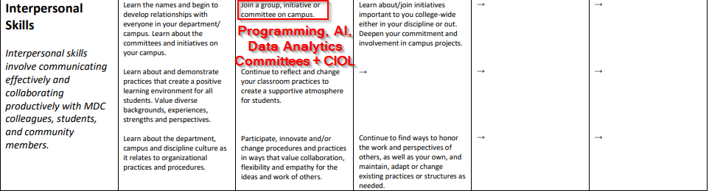
Interpersonal Skills: Committees and CIOL

Slide 7
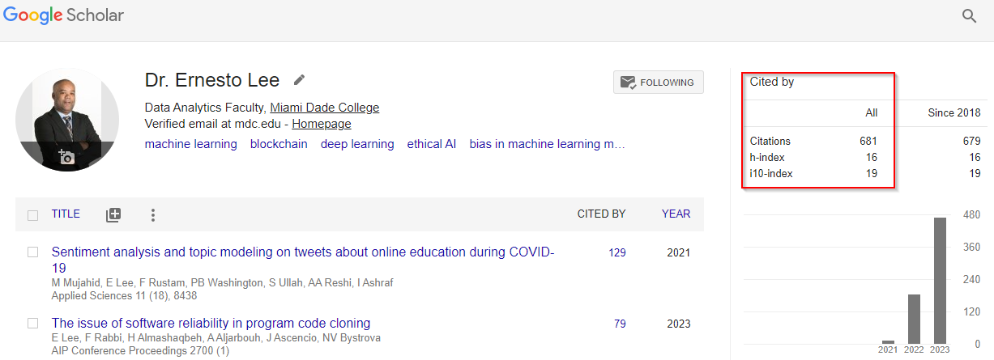
Discipline Expertise
“Experts were once amateurs who kept practicing.”
― Amit Kalantri
Notes:
"In the ever-evolving field of Data Analytics and Data Science at Miami Dade College, my role transcends the mere dissemination of knowledge. It is about embodying the spirit of discovery and serving as a beacon of expertise for my students. I am committed to a pedagogy that is grounded in the latest advancements of the discipline, delivering content that is as engaging as it is educational. By marrying complex theories with hands-on applications, I ensure that the principles of data science are not only understood but also seen as tools of innovation, capable of unlocking new possibilities and pathways for my students.
The interdisciplinary nature of data science demands an approach that weaves together diverse strands of knowledge, from computer science to business analytics. My classes are a testament to this synergy, crafting a learning environment that equips students with a holistic view of the field. Through the integration of cutting-edge technologies and collaborative endeavors, I not only bolster my own expertise but also foster a community of learning that extends beyond the walls of MDC. It is this symbiosis of academic rigor, technological proficiency, and real-world relevance that underpins my teaching, aligning with the college's mission to prepare students fully for the challenges and opportunities of the data-driven world."
----
"As a faculty member specializing in Data Analytics and Data Science at Miami Dade College, my commitment to discipline expertise is not just about possessing substantial knowledge; it's about being a role model for my students in a field that is constantly evolving. This commitment means staying inquisitively engaged with the latest developments, theories, and practices in data science. My role is to not only understand these elements but to effectively convey them in ways that resonate with and inspire my students. It's about bridging the gap between complex theories and practical applications, making the subject matter both accessible and relevant.
In the realm of data science, integrating multiple perspectives is crucial. The field is interdisciplinary by nature, intersecting with areas like computer science, statistics, and business. In my classes, I strive to bring these perspectives together, representing the ongoing work of experts in these areas. This approach not only enriches the learning experience but also prepares students for the multifaceted nature of problems they will encounter in the real world. Utilizing current and innovative technologies is another key aspect of my teaching. Whether it's introducing new data visualization tools, machine learning algorithms, or big data processing techniques, I ensure that my students are adept at using the latest tools relevant to their discipline.
Networking and collaboration with peers, both within and outside of MDC, are integral to maintaining discipline expertise. Participating in professional projects and research not only enhances my own understanding but also contributes to the collective knowledge of the field. These collaborations often transcend traditional discipline boundaries, leading to inter-professional efforts that reflect the dynamic nature of data science. Moreover, aligning my work with MDC's Learning Outcomes ensures that the education provided is not only academically sound but also has real-world applicability. This alignment is critical in a field like data science, where theoretical knowledge must be complemented with practical skills to solve real-world problems.
In summary, my discipline expertise in Data Analytics and Data Science is a blend of deep academic knowledge, a commitment to staying current with technological advancements, and a dedication to inter-disciplinary collaboration, all aligned with the educational goals of Miami Dade College."

Slide 8
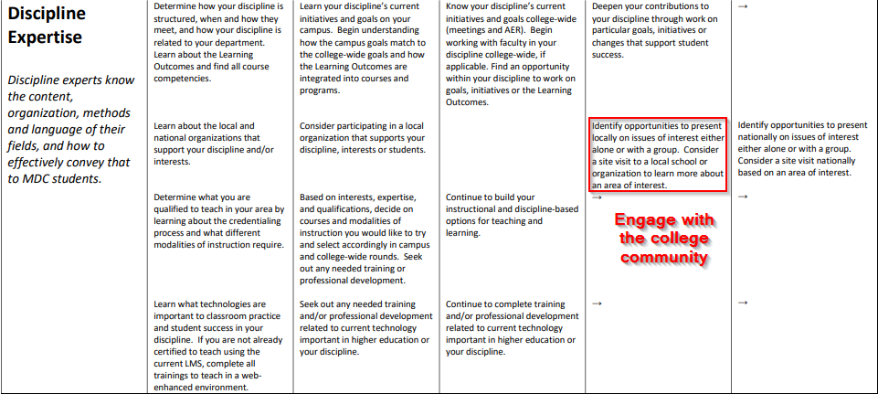
Discipline Expertise: Engagement

Slide 9
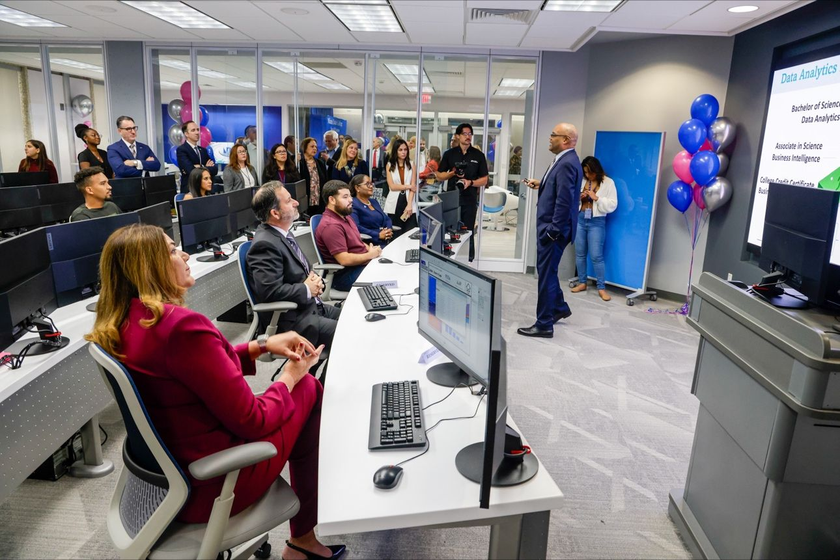
Teaching Expertise
“They inspire you, they entertain you, and you end up learning a ton even when you don’t know it” –Nicholas Sparks
Notes:
"In my capacity as a Data Analytics and Data Science instructor at Miami Dade College, my approach to teaching skill is anchored in the belief that exceptional instruction transforms student learning. This transformation is achieved by providing students with a blend of established and innovative learning methods that spark intellectual curiosity, creativity, and critical thinking. My classroom is a dynamic environment where traditional lectures interweave with interactive, technology-driven experiences. By incorporating a variety of experiential, collaborative, and tech-based learning opportunities, I ensure that students not only grasp complex data science concepts but also apply them innovatively in real-world scenarios.
A crucial aspect of my teaching is being attuned to students' learning progress, allowing me to assess and adjust my teaching strategies in real-time. This adaptive approach ensures that instruction is always aligned with students' needs, enhancing their learning experience. Continuous improvement in teaching is another area I focus on, utilizing feedback from students and colleagues, and engaging in ongoing professional development. This commitment to improvement is also reflected in how I assess student learning. By providing fair, constructive, and timely feedback, I aim to positively influence their learning journey, encouraging them to see the value of their discipline, the significance of higher education, and the importance of lifelong learning."

Slide 10
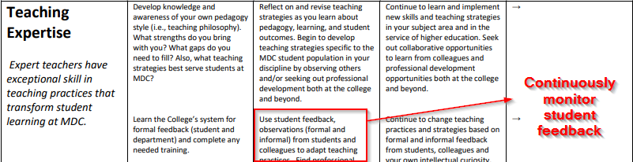
Teaching Expertise: Grade the Graders

Slide 11
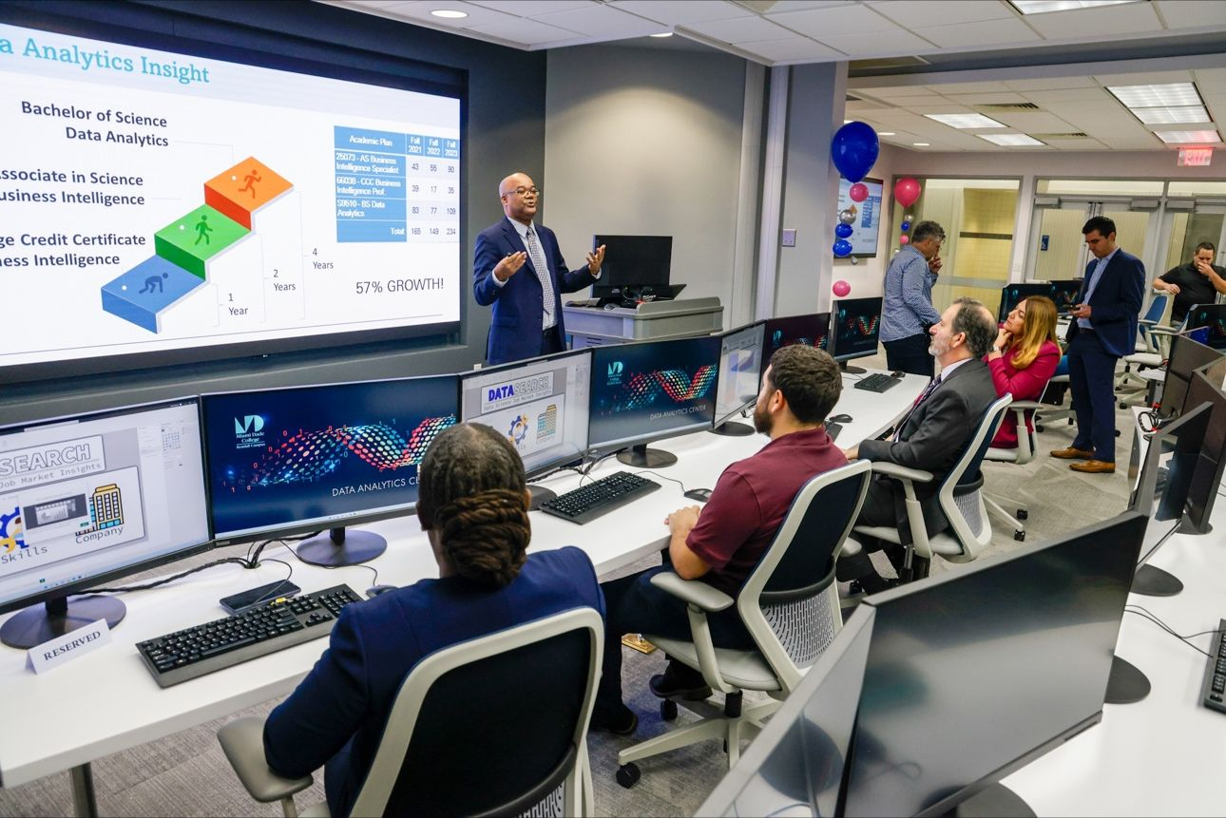
Gratitude
"Feeling gratitude and not expressing it is like wrapping a present and not giving it.“
Thank you Dr. Zhang
Thank you Dr. Coffman
Thank you Colleagues
Notes:
"As I stand here at the conclusion of this enriching year at the Faculty Success Academy, I find myself reflecting on the journey that has brought me to this moment. It's a journey marked not just by learning and growth, but by the invaluable support and guidance I've received along the way.
I would like to extend my deepest gratitude to Dr. Coffman. Your mentorship has been a beacon of wisdom and inspiration throughout this academy. Dr. Coffman, you have not only been a teacher but a guiding light, helping me navigate the complexities of our profession with grace and expertise. Your unwavering support and insightful advice have been instrumental in shaping my approach to teaching and personal development. Your example as a dedicated educator and a compassionate mentor will continue to inspire me in all my future endeavors.
To my esteemed colleagues, your camaraderie and collaborative spirit have made this journey not only successful but truly enjoyable. Each one of you has contributed to my experience in unique and meaningful ways, offering perspectives that have enriched my understanding and approach to teaching. The environment of mutual support and shared growth that we've cultivated is something I will always cherish.
As this chapter closes and another beckons, I carry forward the lessons learned, the friendships forged, and the inspiration gained from each one of you. Thank you, Dr. Coffman, and thank you to all my colleagues, for making this year at the Faculty Success Academy a truly remarkable and transformative experience."
Perhaps the most obvious connection between the modern concept of Flow and Zhuangzi is found in his description of skilled artisans such as teachers whom I shall call “blue collar sages.” This is one that is near to my heart since I come from a long line of teachers. I often think of the feeling of being in a classroom while simultaneously being an introvert. To me, this experience feels like this: At every change of a slide, every look of engagement, every move on my feet, every complicated concept made simple to the class - I feel absolutely exhilirated and simultaneously at peace. I move throughout the room with confidence and in a perfect rhytm, as if I were performing an ancient dance. I was once asked to train other teachers and my response was: What I care about is the Way, which goes beyond skill and is more about living "in the moment". When I first began teaching, all I could see were the individual students. After many years I no longer see the students...I see the class. I go at it by spirit and don't look with my eyes. Perception and understanding have come to a stop and spirit moves where it wants. However, whenever I come to a complicated concept, I size up the difficulties, tell myself to watch out and be careful, keep my eyes on what I'm doing, explain very deliberately...very slowly, and move through the concept with the greatest subtlety, until-- a difficult concept is explained simply! The entire room clicks and I can look into the eyes of my students and know that they have grown from this experience and they will never be the same. I stand there holding on to the moment while looking all around me, completely satisfied and reluctant to move on, and then I wipe the sweat from my brow and move on with the class.

Slide 12
Questions?
Notes:
In closing, I trust this presentation has provided a comprehensive overview of the proposed Advanced Technical Certificate in Cloud DevOps and its potential to enrich our academic repertoire while meeting the industry's current and future needs. I welcome any questions, comments, or feedback you may have, as your insights are invaluable in refining and perfecting our approach.
Most importantly, I seek your approval to proceed, ensuring that together, we can continue to foster an educational environment that not only responds to the demands of the tech industry but actively shapes the future of our students' careers.

